Slide 1
Documents
6.0
21 September 2009
Notes:
Documents - <number>
Guidewire training materials contain Guidewire proprietary information that is subject to confidentiality and non-disclosure agreements. You agree to use the information in this manual solely for the purpose of training to implement Guidewire software solutions. You also agree not to disclose the information in this manual to third parties or copy this manual without prior written consent from Guidewire. Guidewire training may be given only by Guidewire employees or certified Guidewire partners under the appropriate agreement with Guidewire.

Slide 2
Lesson Objectives
By the end of this lesson, you should be able to:
  Describe the functionality of documents
  Create documents
  Create emails
  Work with documents
  This lesson uses the notes section for additional explanation and information.
  To view the notes in PowerPoint, choose View→Normal or View→Notes Page.
  If you choose to print the notes for the lesson, be sure to select “Print hidden slides.”
Notes:
Documents - <number>

Slide 3
Lesson Outline
Document Basics
Creating Documents
Creating Emails
Working with Documents
Notes:
Documents - <number>

Slide 4
Documents
We received notice of an accident involving an automobile owned or operated by you on October 04, 2009.
A ClaimCenter document is a document which contains information relevant to the claim
Documents are either:
  Physical pieces of paper (such as a photograph of damaged property), or
  Electronic files (such as a PDF, Word or Email document)
Notes:
Documents - <number>
Documents can be used to:
Track information on physical pieces of paper that document the loss (such as photographs of a damaged car or diagrams of the floor plan for a workplace)
Track information on physical pieces of paper that are used to process the claim (such as assessments from mechanics or diagnoses from a doctor)
Record all correspondences with claimants, including emails

Slide 5
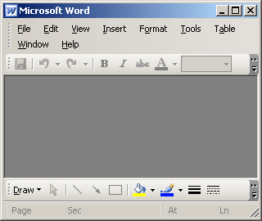
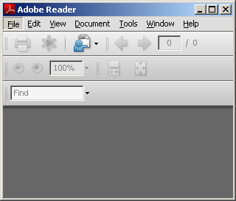
Important Document Attributes
???
Each document has a MIME type
  This is used by the user's local machine to determine what application to use to view a document (such as using Adobe Acrobat for PDF files)
Each document has a security type
  Sensitive documents are visible only to you, your supervisors, and people with permission to view sensitive documents
Notes:
Documents - <number>
Documents in the base application have additional attributes, but there is no significant functionality tied to these attributes. These attributes can be configured and additional attributes could be added.

Slide 6

Three Ways to Create a Document
Identify that
a paper document exists
User Machine
ClaimCenter
Doc Storage
Link (upload) an existing electronic file
User Machine
ClaimCenter
Doc Storage
Create a doc from a ClaimCenter document template
User Machine
ClaimCenter
Doc Storage
Notes:
Documents - <number>
There are three ways to create a document. You can:
Create a simple record that identifies that a paper document exists (and that there is no electronic copy of it to be stored in the document management system).
Upload an existing electronic file from your machine to the document management system.
Create a new document using a ClaimCenter document template, which creates a local copy on your machine which is ultimately uploaded to the document management system.

Slide 7
Lesson Outline
Document Basics
Creating Documents
Creating Emails
Working with Documents
Notes:
Documents - <number>

Slide 8

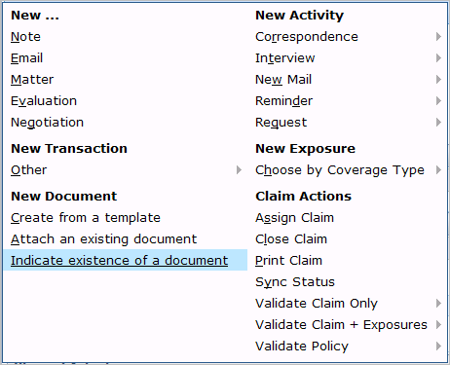
The New Document Menu
To create a new document, navigate to the appropriate claim and select the appropriate New Document menu item
Notes:
Documents - <number>
You can also create a document from an activity. This is discussed later in this lesson.

Slide 9

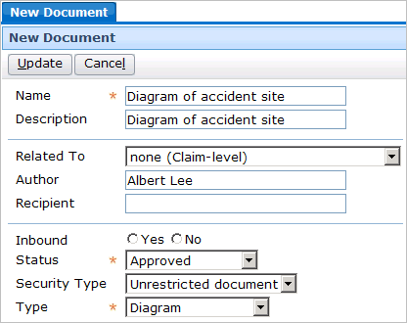
Adding Records of Paper Documents
Notes:
Documents - <number>
To add a document which is "known to exist" (but is not stored in the document management system):
Select the "Indicate the existence of a particular document" menu item.
Specify the information about the document.
Click Update.

Slide 10

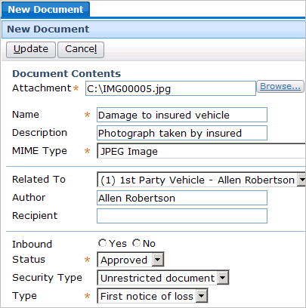
Adding Existing Documents as Attachments
Notes:
Documents - <number>
To add an electronic document which already exists on your computer (or in a location you can navigate to):
Select the "Link an existing document to this claim" menu item.
Navigate to the document by clicking the Browse button.
Specify the information about the document.
Click Update.

Slide 11
Adding Documents By Using a Template
User Machine
ClaimCenter
Doc Storage
Adding a document by using a template is a multi-step process which involves:
  Selecting the template
  Generating the document
  Modifying the document text
  Specifying any additional values
  Saving the document
Notes:
Documents - <number>

Slide 12

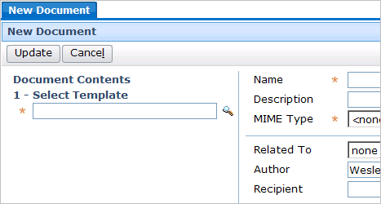
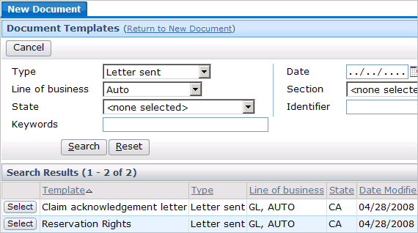
Adding Document Via Template
Step 1: Select the Template
Notes:
Documents - <number>
To select the template from which to generate a new document:
Click the "Create a from a template" menu item.
In the New Document screen, click the search icon.
In the Document Templates screen, search for and select the appropriate template.

Slide 13
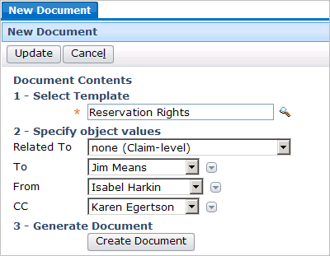
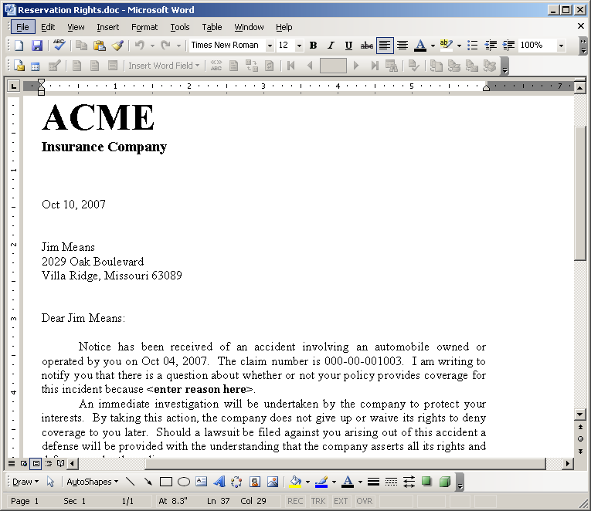
Adding Document Via Template
Step 2: Generate the Document
Notes:
Documents - <number>
Once you have selected the appropriate template, you typically also need to specify which objects ClaimCenter will use when generating the document. For example, a Reservation Rights is sent to someone and from someone. Before generating the document, you need to specify which claimant the letter is addressed to (Jim Means in the example above) and which adjuster the letter is coming from (Dana Evans in the example above).
When you are done specifying the objects, click Create Document. ClaimCenter generates a document using the template and the objects specified, and opens the document in the appropriate application window (such as opening a Word document in Microsoft Word).

Slide 14


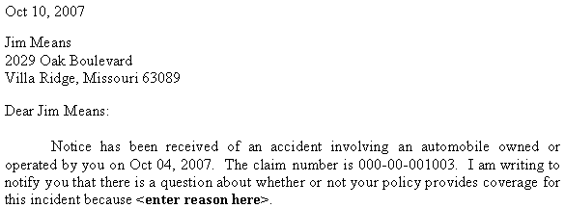
Object Values in Template Documents
system
date
contact:
Jim Means
claim:
000-00-001003
Notes:
Documents - <number>
The slide above shows how information from the claim and the specified objects are used in the document. For example:
The system date is used to insert a date in the letter.
The specified claimant is used to insert the claimant's name and mailing address.
The associated claim is used to insert the data of the loss and the claim number.

Slide 15

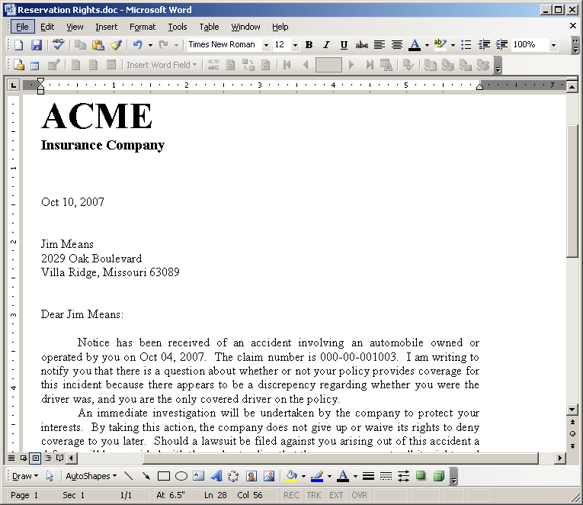

Adding Document Via Template
Step 3: Modify the Document Text
Notes:
Documents - <number>
The document text is modifiable. It is common practice for certain values in the document to be "boilerplate" text which the adjuster is expected to replace. The adjuster should review the document, modify it as appropriate, and then close the modified document.

Slide 16
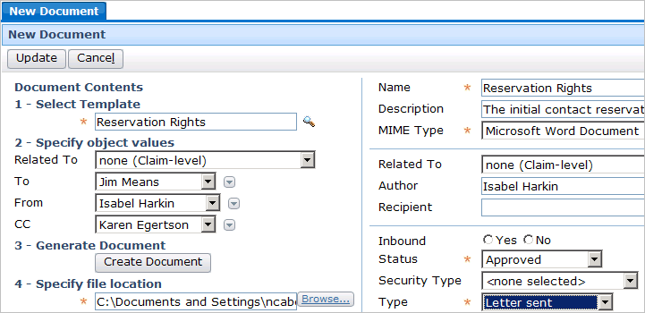
Adding Document Via Template
Step 4: Specify Any Additional Values
Notes:
Documents - <number>
Once the document has been modified, you specify any additional values about the document, including;
Required fields that may need to be set, such as Name and Status (In the base application, MIME Type and Type are automatically set.)
Non-required fields which may need to be specified based on the business scenario (such as what the document is related to and whether it is sensitive)

Slide 17
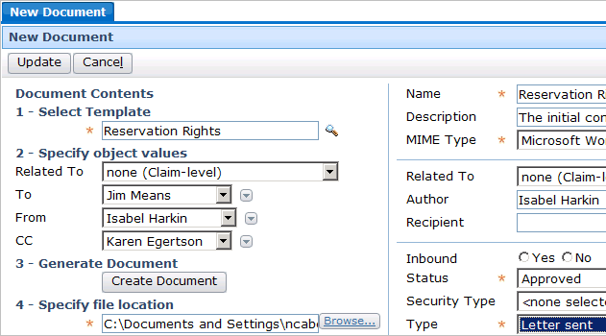
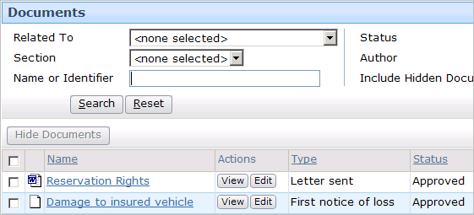
Adding Document Via Template
Step 5: Save the Document
Notes:
Documents - <number>
When you are done, click Update. This uploads the local copy of the document from your machine to the document management system.

Slide 18
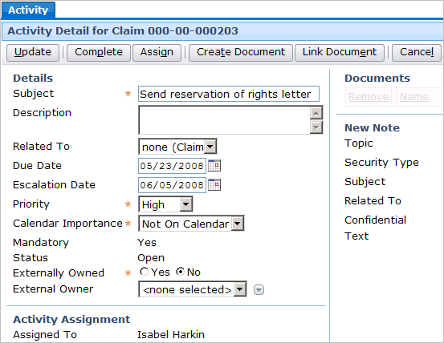
Documents and Activities
Notes:
Documents - <number>
Recall that activities are created from activity patterns. An activity pattern can be associated to a document template. When this is done, every activity created from the pattern has a "Create document" button. Clicking this button lets a user create a document using the template specified in the activity pattern.
All activities, regardless of the pattern from which they were created, can be linked to existing claim documents. To upload (link) an existing document to an activity, click the Link Document button in the Activity Detail toolbar. This displays a screen of existing documents for the claim. You can choose the appropriate document, which then becomes linked to the activity.

Slide 19
Lesson Outline
Document Basics
Creating Documents
Creating Emails
Working with Documents
Notes:
Documents - <number>

Slide 20
Outbound Email
Emails are a form of document that may be sent from ClaimCenter
  Optionally stored as a document of the claim
  May use templates to produce
Emails are used by Adjusters . . .
  to send claim status information to the insured
  to send documents to the attorney or an outside vendor
Emails can automatically be associated with activities
Emails can be sent automatically via business rules
Notes:
Documents - <number>
How to generate emails automatically via business rules is not within the scope of this course, but is a task performed by a rule writer.

Slide 21
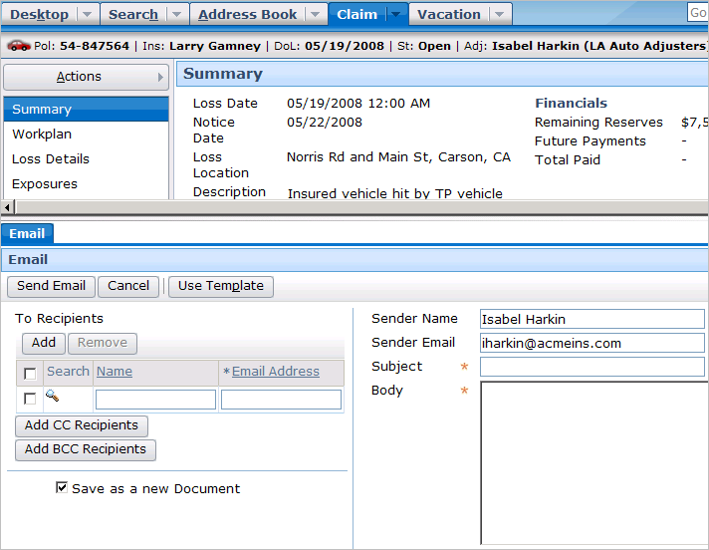
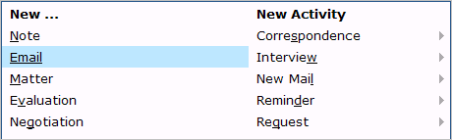
Creating a New Email – Menu Action
Notes:
Documents - <number>
Emails are created by a menu action separate from that of the new document. But similar to the new document menu action, a worksheet is opened up for creating the new email.
The checkbox to “Save as a new Document” is the default behavior when creating a new email. This results in a copy of the sent email being stored as a document.

Slide 22
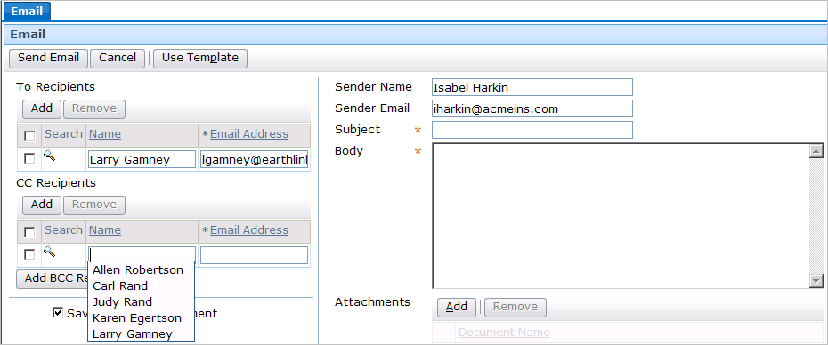
Creating New Email – Recipients
All claim parties involved will display as possible recipients
Recipients may be searched for using Address Book
An Email address will automatically be displayed if available
Notes:
Documents - <number>

Slide 23
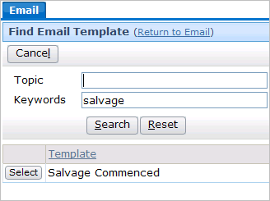
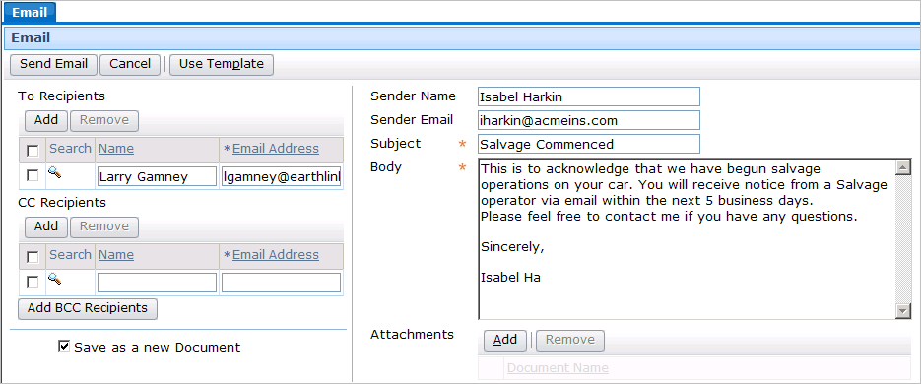
Creating New Email – Message Body
Enter text manually or use pre-defined templates
Optionally add claim-related documents
Notes:
Documents - <number>
The body text (as shown inside the red container) was pre-populated with the contents from the template. The adjuster has begun entering her name and contact info to personalize the message. Any portion of the template is modifiable by the adjuster.
Unlike Document Templates there is no automatic population with Claim data in the email template body.

Slide 24
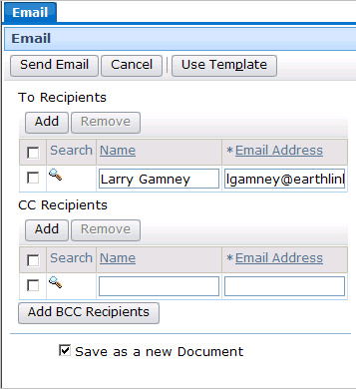
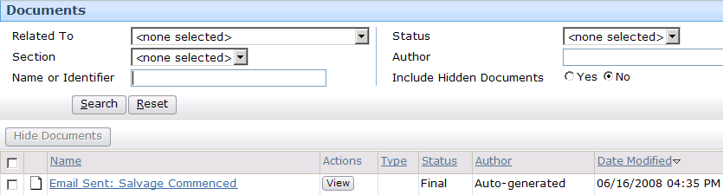
Sending New Email
Clicking the Send Email button causes the email to be sent to the recipients
If you check “Save as a new Document” the email is stored as one of the Claim documents
Notes:
Documents - <number>

Slide 25
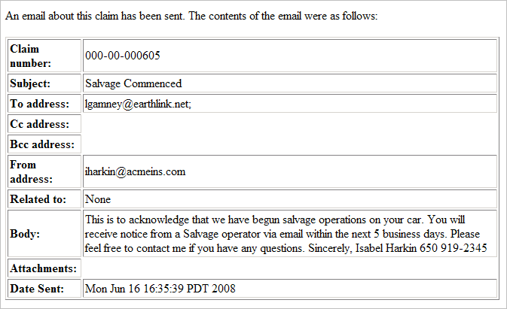
Viewing a Sent Email
Notes:
Documents - <number>

Slide 26
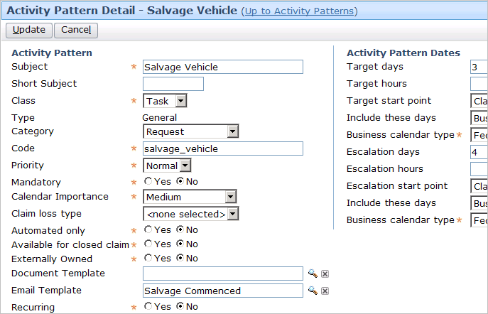
Associating Email Templates with Activities
Notes:
Documents - <number>

Slide 27
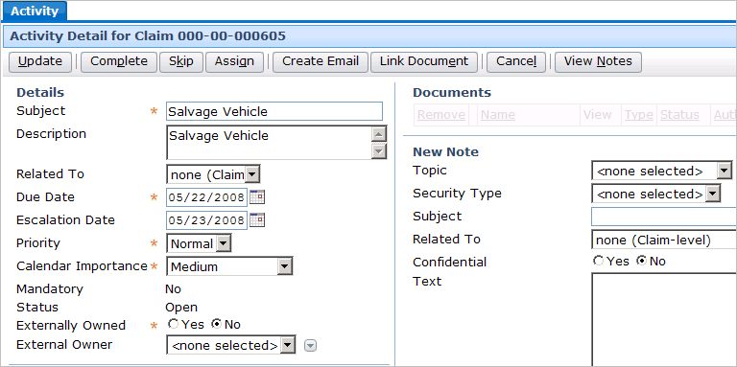
Sending Emails from Activities
When activity is open the Create Email button displays
Selecting the Create Email button opens up a popup in the worksheet containing a New Email screen
Notes:
Documents - <number>

Slide 28
Lesson Outline
Document Basics
Creating Documents
Working with Documents
Notes:
Documents - <number>

Slide 29
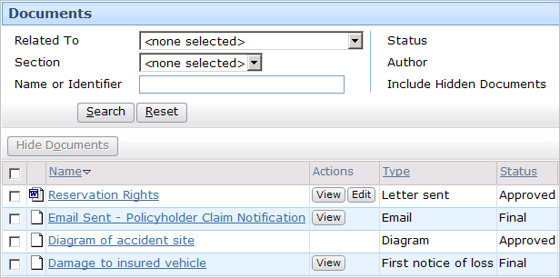
The Documents Screen
All documents, regardless of how they were created, appear on the Documents screen
  However, a document may not be listed if it is marked sensitive or hidden
Notes:
Documents - <number>
You can hide a document, which simply prevents the document from being displayed in the document list by default. Hiding a document is analogous to "logically deleting" the document. It is still listed inside the database and can still be seen in ClaimCenter, but it has also been flagged as a document which is potentially irrelevant to the processing of the claim.
There is a search criteria which lets you specify that hidden documents should be returned in the search.
Recall that sensitive documents are visible only to you, your supervisors, and people with permission to view sensitive documents.

Slide 30
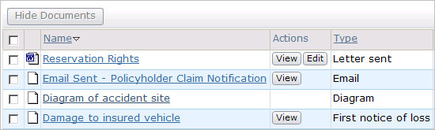
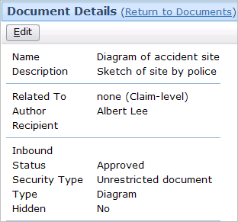
"Known to Exist" (Paper) Documents
You can view or edit the data about the document, but because it is only known to exist, you cannot view the document itself
Notes:
Documents - <number>

Slide 31
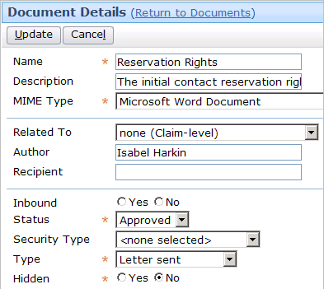
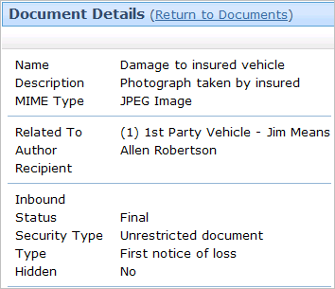
Viewing Data About Electronic Documents
Data about stored documents may be viewed and edited unless the Status is set to Final
Notes:
Documents - <number>
If a document is electronic (which means it is stored in the document management system), then you can both view and edit the data about the document as well as view the document itself. The slide shows how to view and edit the data about the document.

Slide 32
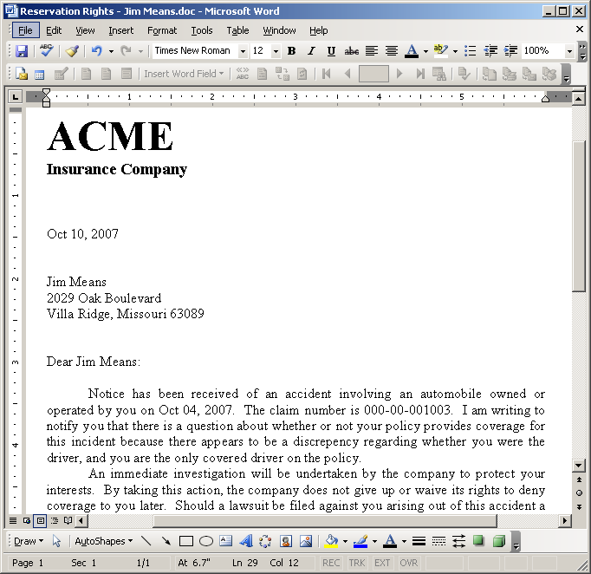
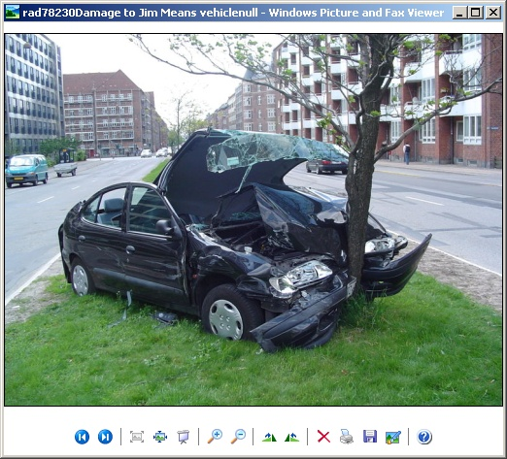
Viewing Electronic Documents
Notes:
Documents - <number>
If a document is electronic (which means it is stored in the document management system), then you can both view the data about the document as well as view the document itself. The slide shows how to view the document itself.
In some cases, such as when the status is final, you can view a document but you cannot edit it. When this occurs, the document has a View button but no Edit button.

Slide 33


Editing Electronic Documents
edit local copy
User Machine
ClaimCenter
Doc Storage
upload
Notes:
Documents - <number>
Assuming you have sufficient permissions, you can edit electronic documents. To edit a document, click the Edit button. When you do this, ClaimCenter downloads a local copy of the document to your machine and opens it in the appropriate application (such as opening a Word document in Word). It also replaces the View and Edit buttons in the Actions cell with three new buttons:
Edit Local Copy - This button opens the local copy of the document in the appropriate application. This is useful if you inadvertently close the application window that ClaimCenter automatically opens for you.
Upload - This replaces the "master" copy of the document in the document management system with your local copy. You would use this button after you make edits to the local copy and want those edits to be in the master copy.
Cancel - This severs the link between your local copy of the document and the master copy of the document, and this reverts the Actions buttons to View and Edit.

Slide 34
Lesson Objectives Review
You should now be able to:
  Describe the functionality of documents
  Create documents
  Work with documents
Notes:
Documents - <number>

Slide 35
Review Questions
What is the primary difference between a document "known to exist" and an electronic document?
What is the significance of a document's MIME type?
What are the two ways that electronic documents can be added to ClaimCenter?
When a document already exists in ClaimCenter and you choose to edit it, where is the edited copy stored while it is being edited? What must you do to have the edited copy replace the master copy?
Under what circumstance might a user edit a document created from a template before uploading it to the document management system?
Notes:
Documents - <number>
Answers
1. A document "known to exist" is not stored in the document management system (and therefore cannot be viewed or edited). An electronic document is stored in the document management system (and therefore can be viewed and possibly edited).
2. A document's MIME type identifies what kind of document the document is, which is used by the user's machine to determine the application to use when viewing the document.
3. Documents can be added by:
- Uploading (linking) an existing document
- Creating a new document from a template
4. The edited copy is stored on your machine. To have it replace the master copy, you must click the Upload button on the Documents screen.
5. A user might edit a document if there is text in the document that varies greatly and can only be specified by a user (such as the reason for a reservation of rights letter). Typically, a user does not have to edit a document to provide names, addresses, claim numbers, dates, and any other information which is already stored by ClaimCenter. This information can automatically be inserted into the document.

Slide 36
Reservation of Rights
Copyright © 2009 Guidewire Software, Inc. All Rights Reserved.
This file and the contents herein are the property of Guidewire Software, Inc. Use of this course material is restricted to students officially registered in this specific Guidewire-instructed course. Replication or distribution of this course material electronically or in paper format is prohibited without express permission from Guidewire.
Guidewire, Guidewire Software, Guidewire ClaimCenter, Guidewire PolicyCenter, Guidewire BillingCenter, Guidewire ContactCenter, Guidewire Insurance Suite, Guidewire Education, and the Guidewire logo are trademarks or registered trademarks of Guidewire Software, Inc. All other trademarks are the property of their respective owners.
Notes:
Documents - <number>

